Slide 2
Table of Contents
The 2nd Totem Cover.......................................1
Overview…………………………………………………....3
Elevator Pitch……….........................................4
Project Description……………………………….......5
What sets this project apart?.........................6-7
Story…………………………………………….................8
Game Play……………………………………………………9
Game Mechanics…………………………………………10-15
Targeted Platforms……………………………………..16
Production Schedule (brief)…………...............17
Project Scope…………………………………..............18-21
Assets Needed………………………………...............22-26
Influences……………………………………….............27
Production Schedule (detailed)……...............28-29

Slide 3
Overview
Theme / Setting / Genre
Sci-Fi Fantasy
Open World similar to Pokemon Sun and Moon but with the feel of Accel World or Sword Art Online and Sword Art Online Alternative: Gun Gale Online.
Turned based MMORPG that allows players to change the rules of the game.

Slide 4
Elevator Pitch
Pitch
Tengoku-SR is a turn based tower defense MMORPG where players use an in-game avatar to explore 9 main locations (worlds/spheres) for items and pets to defeat the 9 Totems.
Players use these items to battle each other with animated avatars (Armies/Minions) using spells that modify the rules of the game as you play, to destroy digital Forts.

Slide 5
Project Description
Tengoku-SR is a turn based tower defense encased in an MMORPG community.
The project will entail creating an open world where players can explore and duel. I have a long term goal of creating a community of generational players who not only love the game but the franchise. With that in mind the game will have a chat feature so players can communicate with each other and the mini-games can be set up as potential spin-offs of the game similar to how Hearthstone was for World of Warcraft.
This plan also includes licensing, merchandising and films/tv.

Slide 6
What sets this project apart?
Reason #1 – Core Game Mechanic
The Game Mechanic (as per the patent) for Tengoku-SR at its core is a turn based tower defense game that is both unique and fun.
Part of the mechanic is it lets players change the rules of the game while dueling. This in turn creates multiple variations of game play when battling.
Reason #2 – MMORPG
Tengoku-SR let’s players immerse themselves in the 9 Spheres of Game World starting in main location of Morning City.

Slide 7
What sets this project apart?(cont)
Reason #3 - The Story
Each player will have the primary quest of finding and dueling the 9 Totems of Game World. Each totem is a spell casting games master with specific abilities; each being a ruler of 1 of the 9 spheres. Along the way players will have side missions and quests.
Reason #4 - Community & Maps
Players will be able to form guilds to go on quests to gather items and pets to be used to battle each other. And also be able to request to borrow each other’s armies, pets and items if they choose. Eventually there will be a map editor to allow players to create and upload new game maps and environments.

Slide 8
Story
You are a Games Caster who must explore the 9 Spheres in search of the 9 Totems, who are the Games Masters that rule the first realm of Tengoku-SR, Game World.
As you go along your quest in search of the 9 Totems you will encounter other Casters who are on their own quests. You can choose to duel or trade with other Casters for items, spells, pets and minions.
You can also ask for their help on missions and in duels. Your ultimate goal is to defeat all 9 Totems and prove yourself a worthy Games Master.

Slide 9
Game play
Brief
Explore an open world to find and challenge the 9 Totems.
Detailed
The 9 Totems are 9 game masters that must be overthrown. To do so you are armed with an inventory of spell cards. These spells allow you to battle other Game Casters in duels, the more you duel the stronger you get. Along the way you find items and collect armies, pets and spells that you use during your duels. Once you are armed with enough spells you can challenge the 9 Totems.

Slide 10
Game mechanics
Brief
Game play Mechanic #1
Exploration
Game play Mechanic #2
Turn based “Tower Defense” battles where characters, environments and rules of the game change based on the spells played from your inventory.
Game play Mechanic #3
Changing the rules of the game

Slide 11
Game mechanics (con’t)
Examples
Example #1 – Casting the spell “Battle Arena” that forces players into a MOBA style mini-battle.
Example #2 – Casting the spell “Atlantis” that forces players to fight underwater.

Slide 12
Game Mechanics (Detailed)
Mechanic #1 - Exploration & being a boss
How it works
Players explore 9 spheres like the Sphere of Games, Sphere of Defeat, the Sphere of Reward and the Sphere of Change. Each map has a big boss, called a totem, to duel.
After beating the original in-game bosses, players can move on to challenge other players in the game via the leader board. These new bosses are players within the MMORPG who at are the top of the leader board and have gained the power of the totems.

Slide 13
Game Mechanics (Detailed)
Mechanic #2
Turned Based Fort Defense where game play mechanics change based on the spells played.
How it works
After being challenged to a duel the BG environment changes from an open world environment to whatever environment spell is played by each Caster.
Each player has:
One turn with 5 actions
Players use these actions to attack, defend and equip minions & forts and also set traps with environments.

Slide 14
Game Mechanics (Detailed)
A duel is over when:
An opponent’s fort(s) are destroyed or
When an opponent runs out of spells to play or
When an opponent has created a 360°defensive perimeter
Mechanic #3 - Rule Changing
The most important rule to remember is that the basic rules mentioned above are subject to change when a new spell is played.

Slide 15
Game Mechanics (Detailed)
How it works
This means that basic rules like the 5 actions explained earlier can be extended indefinitely by playing a spell now creating a mini-game closer to an RTS. Or a spell like “Battle Arena” could be played where it would initiate a mini-MOBA battle.
Mechanic #4 - Environment Changing
How it works
As players duel the losing player’s environment is consumed by the winning player’s environment. These newly acquired environment traps can now be used in future battles as spells.

Slide 16
Monetization
Targeted platforms
Mobile
Consoles
PC
Free to play, play to advance quicker and/or win.
Advertising
Merchandise
Licensing

Slide 17
Production Schedule (Brief)
1st Milestone (est. time 3-6 months)
Build the Game World Hub
Build upon the current base code on the backend while solidifying the GUI on the front end for the main hub.
This would include the directional, behavioral and movement code.
Modifying/Updating current code for a 3d environment.
*See Slides #28 & 29 for detailed schedule

Slide 18
Project Scope
Budget & Game Time Scale
3-5 million
Time table of 12 months to 2 years
Team Size
Core Team Currently – 4 members
Ted Gerard - Product Owner/Game Designer/Art Director

Slide 19
Project Scope (con’t)
George Cochrane - Game Programmer
Rate: Current Industry Standard
Keith Lawson – Programmer (tentative)
Rate: $60 per hr
Looking to add 5 programmers
Vishi Narayan - Senior Business Analyst
Rate - Current Industry Standard

Slide 20
Project Scope (con’t)
UI/UX Design Team (tentative)
Beholder Design
Nick Slough
Ian Wall
Audio/Sound Team (tentative)
Bay Area Sound
Voice Actor (tentative)
Michael A. Zekas

Slide 21
Project Scope (con’t)
Art Team (tentative)
MARS – Concept Art
Popia – Concept Art
Danielle Oyales – Concept Art
Brett Ryans – Animator
Ein Lee

Slide 22
Assets Needed
2D/3D Textures
Environment Textures
Character Animations List
Male Teen Avatar
Female Teen Avatar
The 9 Totems
Gossamer (Sphere of Games)
Thatch (Sphere of Fantasy & Science)

Slide 23
Assets Needed (con’t)
The 9 Totems (con’t)
Brother Raven (Sphere of Time)
Brother Crow (Sphere of Change)
Lady Widow (Sphere of Shadows)
Lizard, the Rogue (Sphere of Torment) – Desert
Judah the Conqueror (Sphere of Hope) – Fire
Lady Songbird (Sphere of Sound)
Willow (Sphere of Magic) – Ancient Library
Note: There are about 500 other characters, items, spells, forts and environments. I have art for about 300 of them including the characters listed above. With art by Ein Lee, Mohd Nur Iman (Popia), Kenneth Loh and Brett Ryans.
Notes:
Note: There are about 500 other characters, items, spells, forts and environments. I have art for about 300 of them including the characters listed above. With art by Ein Lee, Mohd Nur Iman (Popia), Kenneth Loh and Brett Ryans.

Slide 24
Assets Needed (con’t)
Environmental Art Lists
Main Environment – Game World, Morning City
Sphere of Games
Sphere of Fantasy & Science
Sphere of Time
Sphere of Change
Sphere of Shadows
Sphere of Torment (Desert)
Sphere of Hope (Fire)
Sphere of Sound
Sphere of Magic (Ancient Library)
Note -Game World is a central hub and will be an arcade like world with portals to the 9 Spheres and the 9 Totems.

Slide 25
Assets Needed (con’t)
Sound
Sound List (Ambient)
Outside
Game World – Main Level/Hub
Sphere of Games - Level 1
Sphere of Fantasy & Science - Level 2
Inside
Sphere of Games - Level 1
Sphere of Fantasy & Science - Level 2
Foley

Slide 26
Assets Needed (con’t)
Sound List (Player)
Character Movement Sound List
Walking (Ambient)
Running (Ambient)
Other Foley, etc.
Character on Injured / Death sound list
Scream
Pop
Crunch

Slide 27
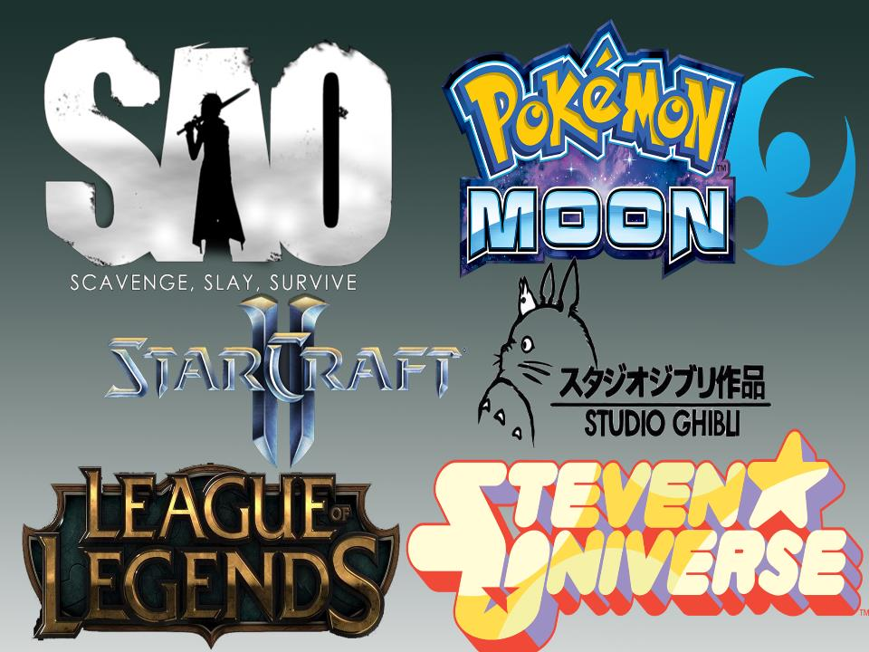

Slide 28
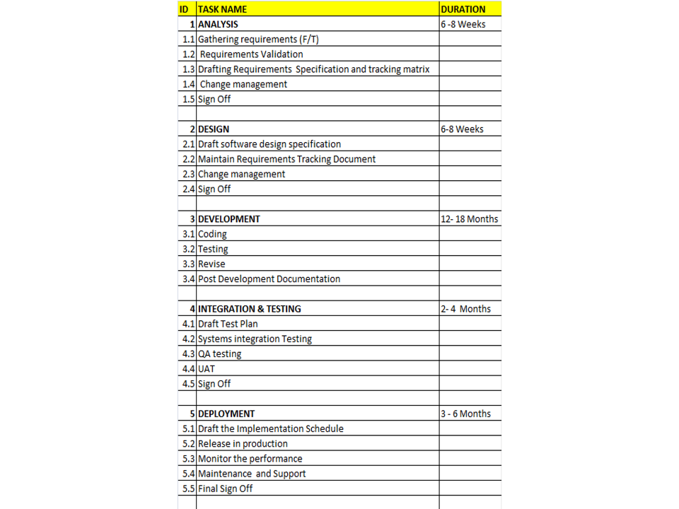

Slide 29
